Slide 1
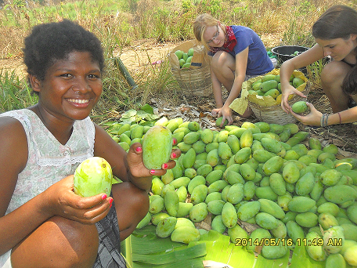
ACCOMPLISHMENTS: PRODUCERS DEVELOPMENT and ORGANIC MANGO DEVELOPMENT PROJECT
Year End Presentation 2014

Slide 2
ACCOMPLISHMENTS: PRODUCERS DEVELOPMENT
A. CARABAO MANGO FARMERS
 | NO. OF GROUPS | NO. OF FARMERS | NO.OF TREES | ESTIMATED HARVEST (kls)
EXISTING | 5 | 76 | 2,084 | 455,690
NEW | 1 | 46 | 1,982 | 482,750
TOTAL | 6 | 122 | 4,066 | 938,440
% INCREASED | 20% | 60.5% | 95 % | 106 %

Slide 3
ACCOMPLISHMENTS: PRODUCERS DEVELOPMENT
B. PICO MANGO FARMERS
 | NO. OF GROUPS | NO. OF FARMERS | NO.OF TREES
2013 | 19 | 311 | 9,130
2014 | 15 | 267 | 7,737
% INCREASED | - 21 % | -14 % | -15.26 %
* Decreased was due to sanctioned as per PREDA Organic Mango IQCS

Slide 4
ACCOMPLISHMENTS: PRODUCERS DEVELOPMENT
B. PICO MANGO HARVEST
COMMUNITY | NO. OF FARMERS | QUANTITY OF HARVEST
PILI | 29 | 41,323
LUMIBAO | 24 | 4,407
BALIWET | 9 | 5,924.4
SABA | 18 | 3,963.6
BATIAWAN | 18 | 8,856.5
ALIBANG | 22 | 5,718
BANGKAL | 18 | 4,186.5
GALA | 1 | 370.5
BAYANBAYANAN | 1 | 888
CADMANG | 15 | 1,670.5
TOTAL | 153 | 77,308

Slide 5
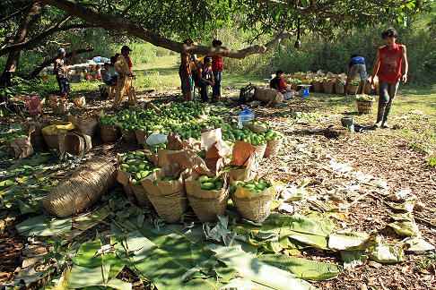
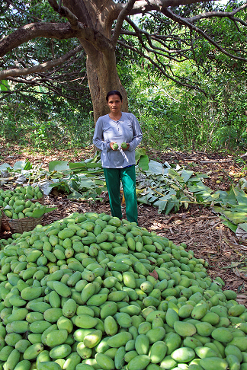
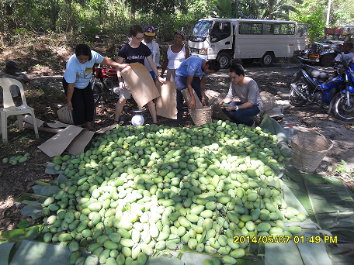
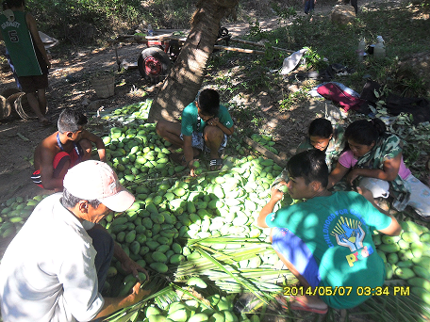
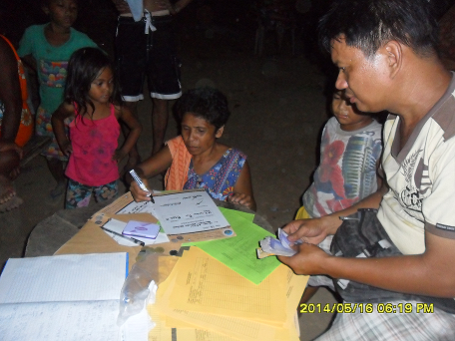
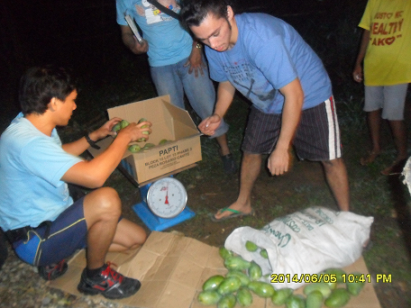

Slide 6
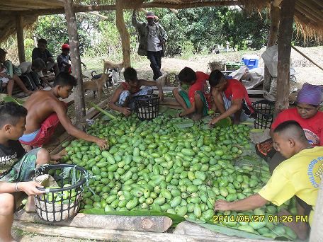
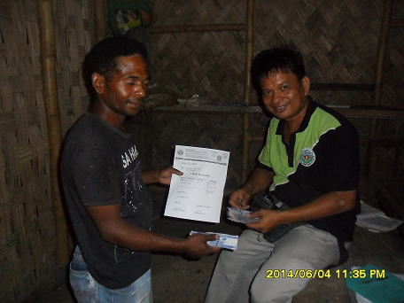
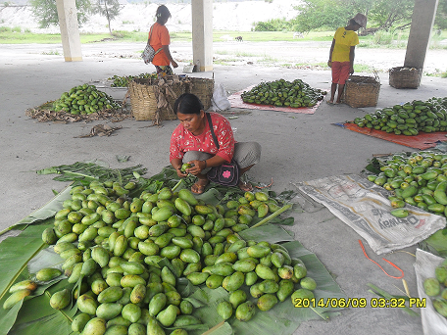
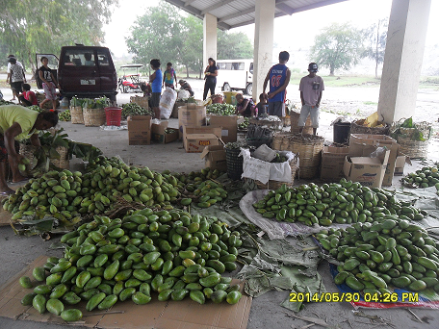
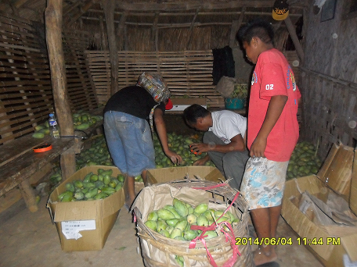
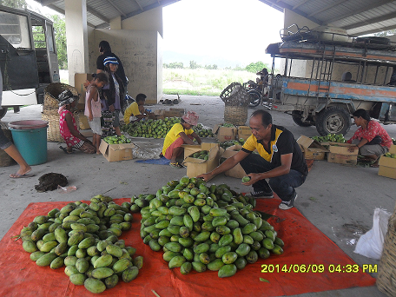

Slide 7
ACCOMPLISHMENTS: PRODUCERS DEVELOPMENT
TRAININGS
Conducted 15 IQCS seminar to 14 Aeta groups conducted 1 seminar for local inspector
Conducted 3 monitoring visit with Preda and FT principle orientation to Davao mango growers. Signing of declaration of commitment to FT principles was also done

Slide 8
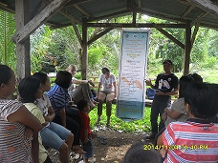
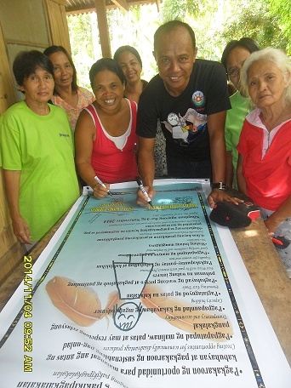
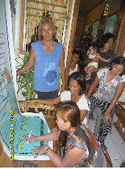
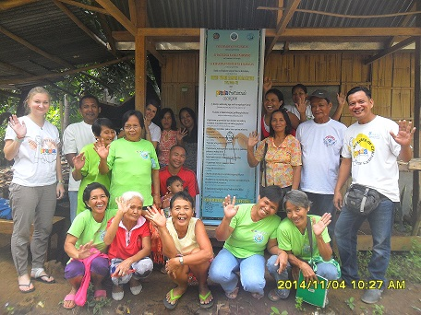
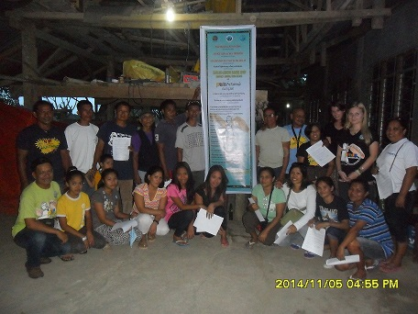
Signing of the Declaration of Partnership and Commitment to the Principles and Practices of Fair Trade

Slide 9
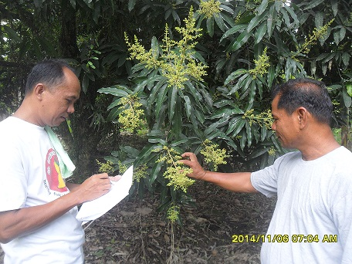
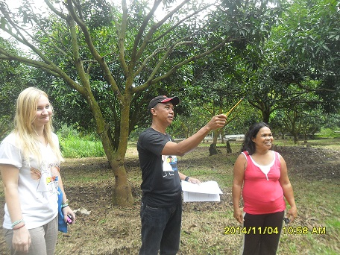
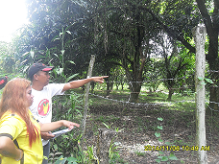
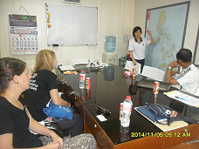
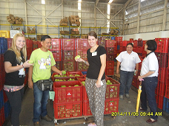
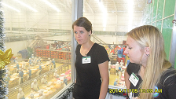
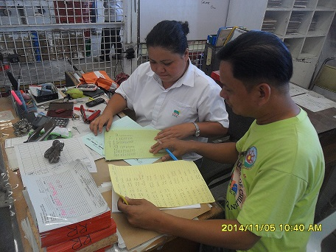
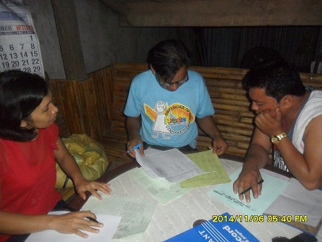
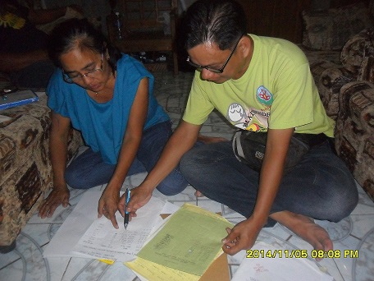
Mango farm validation
Visit to Davao processing plant
Checking of green and yellow card

Slide 10
ACCOMPLISHMENTS: PRODUCERS DEVELOPMENT
FAIR TRADE PREMIUM
YEAR | AMOUNT ( Pesos) | NO. OF FARMERS
June-December 2013 (awarded Jan 26-Feb 1, 2014) | 366,000 | 40
January-May 24 2014 (awarded November 3-7, 2014) | 196,920 | 18
May 25- November 7, 2014 ( to be awarded on Feb 17-21, 2015) | 143,012 | 32

Slide 11
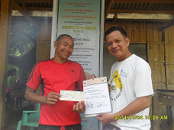
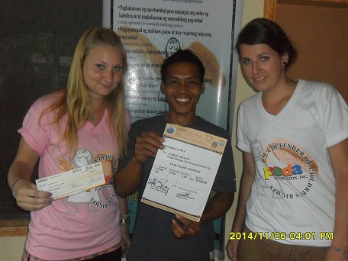
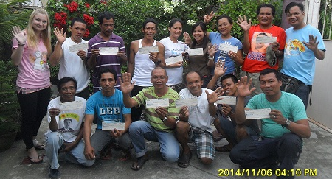
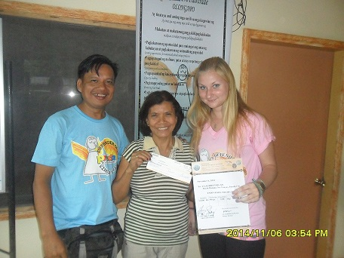
Awarding of Fair Trade Premium

Slide 12
ACCOMPLISHMENTS: ORGANIC MANGO CERTIFICATION
A. EXTERNAL INSPECTION
conducted inspection to processing plant in Profood Cebu and Bulacan
Conducted farmers/field inspection to 4 communities
Center of the inspection is the “PAPER TRAIL”
Recommended tree tagging and colored labeling of crates for traceability

Slide 13
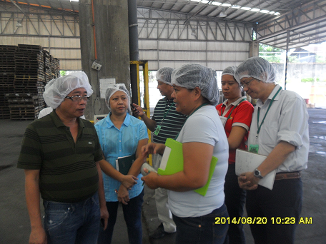
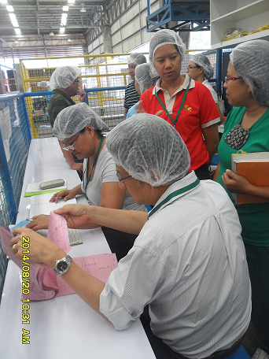
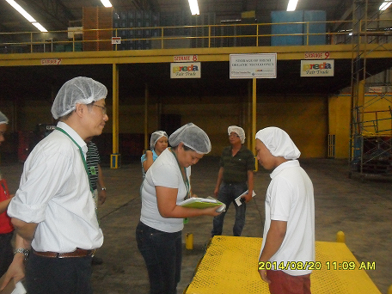
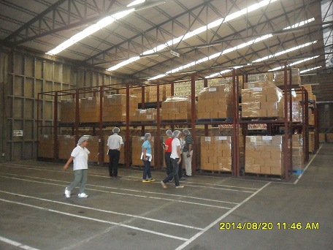
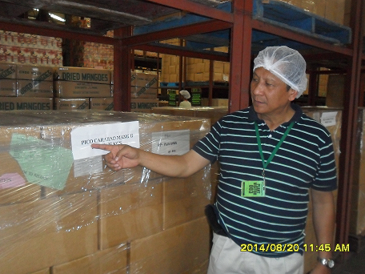
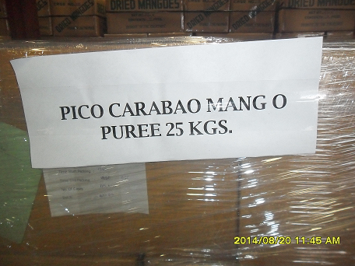
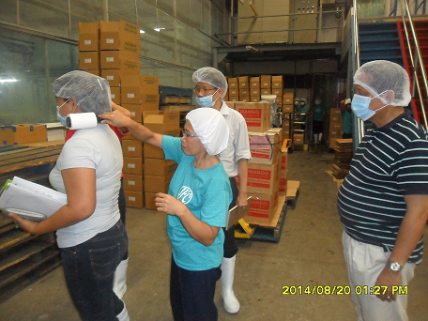
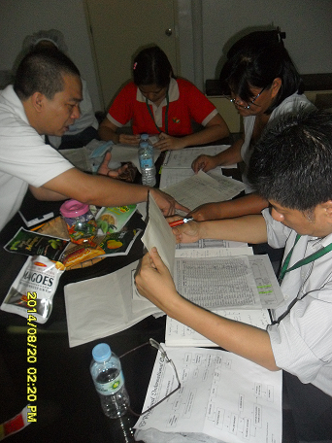
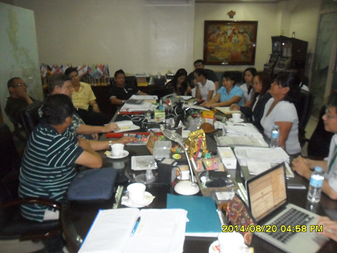
Inspection of Profood Cebu

Slide 14
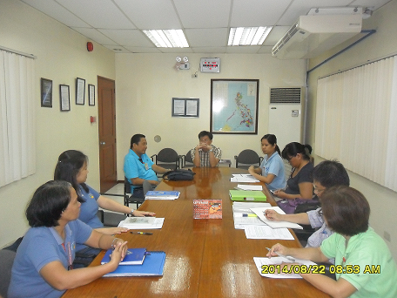
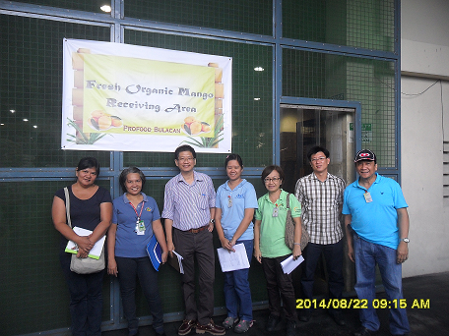
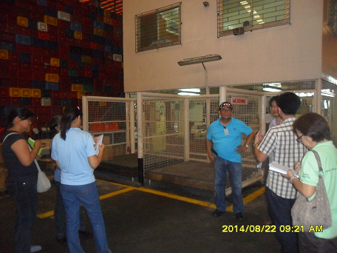
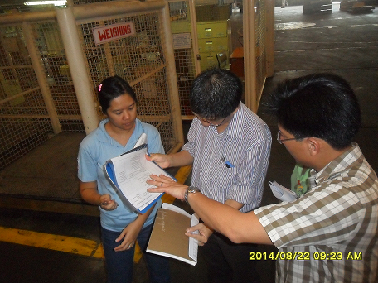
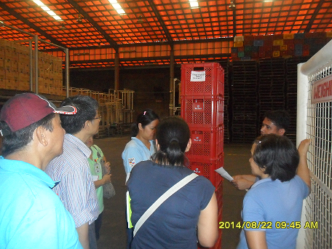
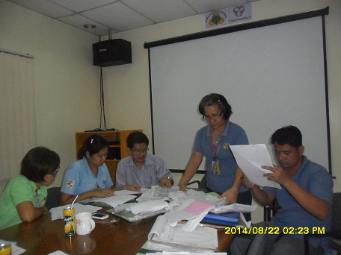
Inspection of Profood Bulacan

Slide 15
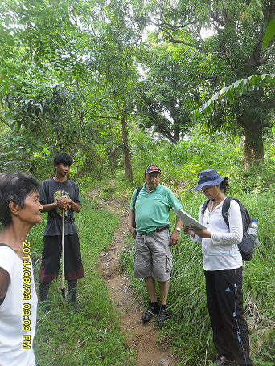
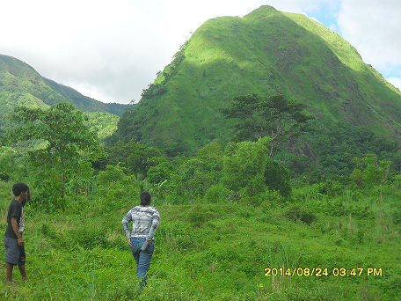
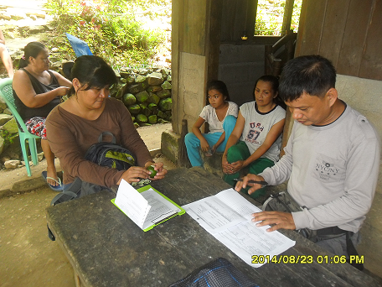
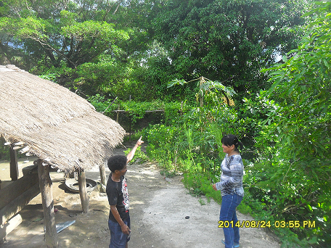
FarmInspection and interview w/ farmers
Exit meeting…

Slide 16
ACCOMPLISHMENTS: PRODUCERS DEVELOPMENT
EDUCATIONAL ASSISTANCE
Sponsor | No. Of Communiies | NO. of Scholars
PFT | 6 | 30 Elementary 50 Highschool 1 College student -successfully graduated BEED and passed LET
Kapatiran | 8 | 16 out of 18 graduated high school
JSF | 4 | 8 College students

Slide 21
ACCOMPLISHMENTS: PRODUCERS DEVELOPMENT
TREE PLANTING:
Planted 3,416 coconut, 500 mango saplings and 852 wildlings to 14 Aeta communities participated by the community members, Preda staff, volunteers, youth and children

Slide 22
ACCOMPLISHMENTS: PRODUCERS DEVELOPMENT
Other projects:
Started to distribute Solar Lights to Aeta communities (Baliwet, Payangan, Bayan-bayanan)
Facilitated construction of 1 hand pump unit to Samahang Aeta ng Banawen

Slide 23
Farmers training…………………

Slide 24
Mango tree tagging…………………

Slide 25
MARAMING SalaMaT PO!

